Slide 1
Generative AI and ML Techniques to Enhance Music Therapy
Farid Vakili

Slide 2
Table of contents
01
02
Music Therapy
Emotion Recognition
03
04
Experiment Design
Music Generation
Rise of Complementary and Alternative Medicine
Using EEGs to detect emotions with ML
How should we respond to the detected emotions?
Techniques and models

Slide 3
01
Music Therapy
The Growing Interest in Complementary and Alternative Medicines

Slide 4
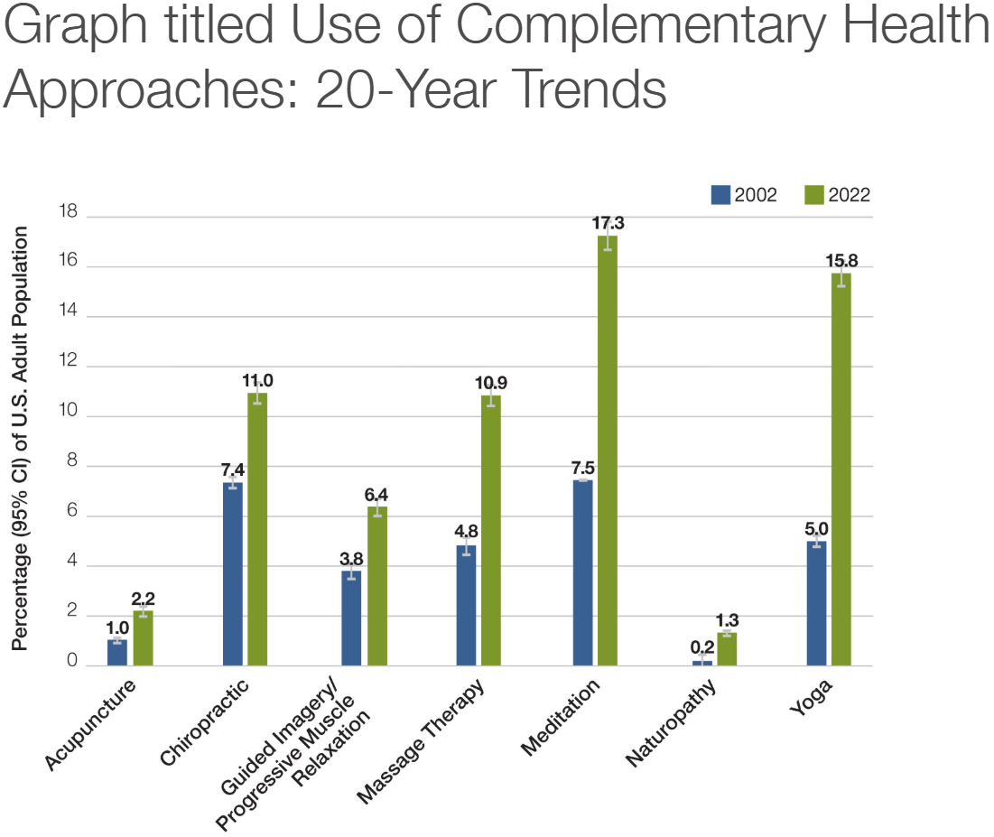
Growing Interest In Complementary and Alternative Medicines
Patients and healthcare providers have shown increasing interest in Complementary and Alternative Medicine (CAM) therapies in recent years. Usage of CAM (things like acupuncture, meditation, art therapy, music therapy, etc.) has risen significantly
https://www.nccih.nih.gov/research/national-health-interview-survey-2022/graph-titled-use-of-complementary-health-approaches-20-year-trends

Slide 5
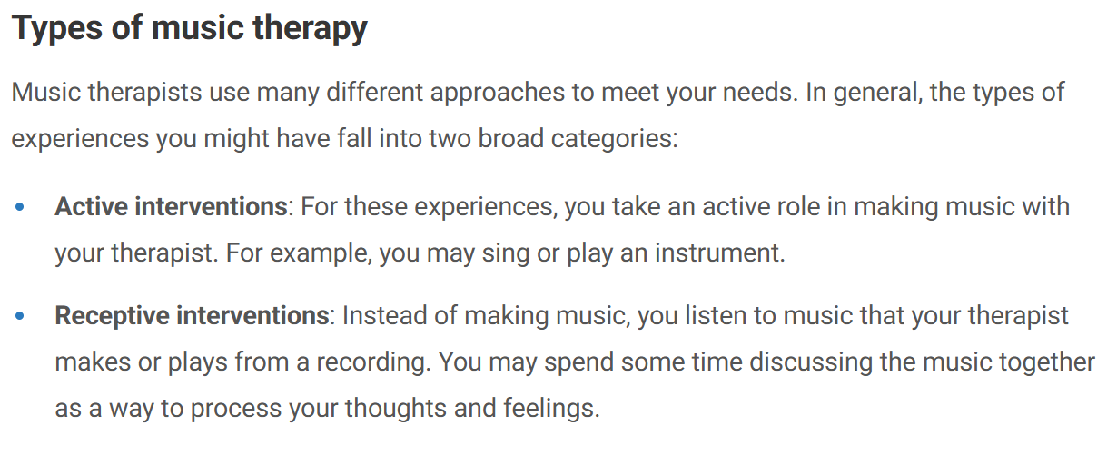
What is Music Therapy?
According to the American Music Therapy Association, it’s “the clinical & evidence-based use of music interventions to accomplish individualized goals within a therapeutic relationship by a credentialed professional”
https://www.musictherapy.org/about/musictherapy/
http://my.clevelandclinic.org/health/treatments/8817-music-therapy

Slide 6
Goals & Benefits of Music Therapy
Reducing anxiety and stress
Alleviating pain
Improve mood and emotional expression
Enhancing memory and cognition
Improving communication
Aiding physical rehabilitation
https://www.musictherapy.org/about/musictherapy

Slide 7

Can we use Machine Learning and Generative AI to assist with this goal?

Slide 8
02
Emotion Recognition
Using EEGs to detect emotions with ML

Slide 9
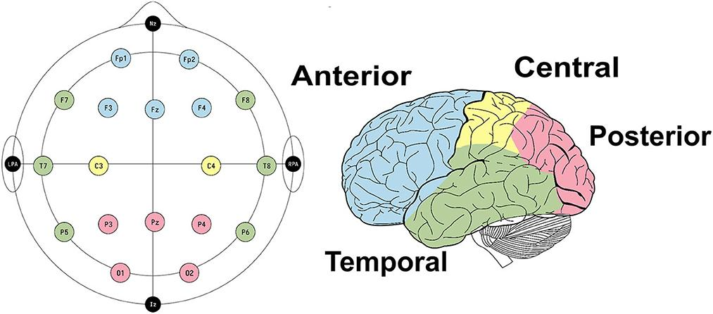
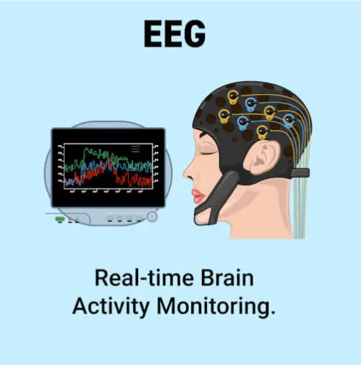
What is Electroencephalography (EEG)?
Electroencephalography (EEG) is a technique that records brain-wave activity through electrodes on the scalp
https://www.frontiersin.org/journals/human-neuroscience/articles/10.3389/fnhum.2023.1274834/full
https://blog.medicai.io/en/what-can-an-eeg-show-that-an-mri-cannot/

Slide 10
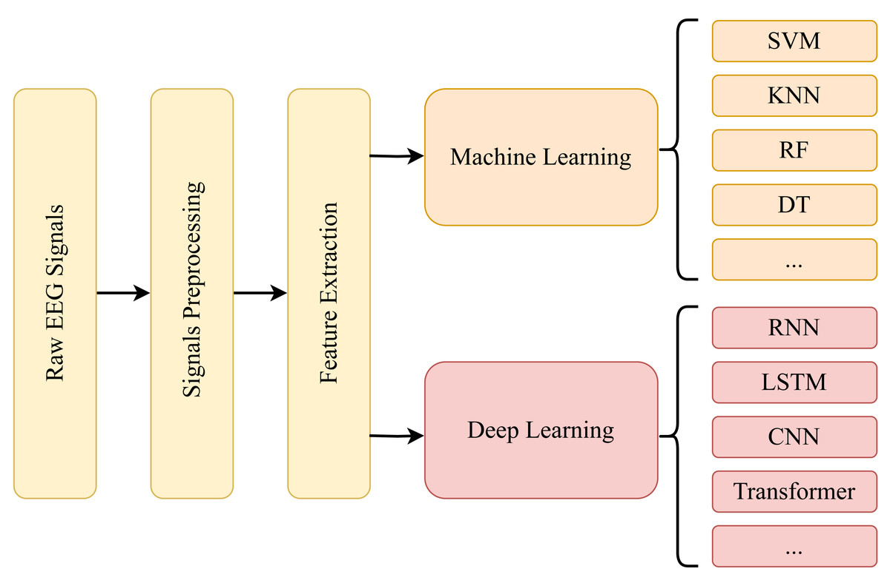
Big Picture
https://peerj.com/articles/cs-2065/

Slide 11
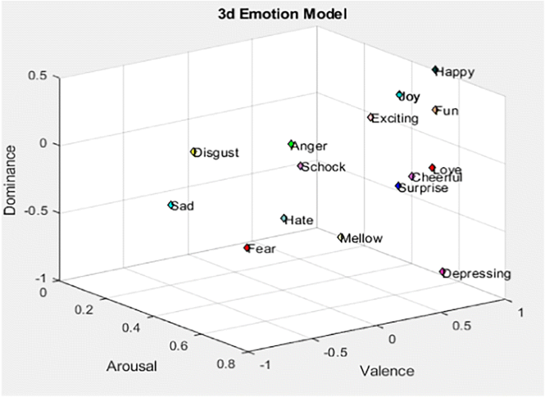
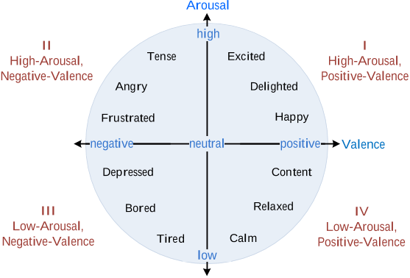
How Do We Classify Emotions?
Valence-Arousal Circumplex model
https://www.researchgate.net/publication/324664655_Seemo_A_Computational_Approach_to_See_Emotions
https://link.springer.com/article/10.1007/s11042-023-14489-9

Slide 12
EEG Signal Preprocessing
Band-pass filtering (0.5-40 Hz) & notch at 50/60 Hz
Keep brainwave bands, remove slow drifts and high-frequency noises
Notch removes powerline hum
Re-referencing (average reference)
Reduces electrode bias and makes channels more comparable
Artifact Handling & Independent Component Analysis (ICA)
Eliminates large non-brain artifacts (removes blinks/muscle/motion)
Resampling and z-scoring
Reduce file size, aligns datasets, and stabilizes ML training

Slide 13
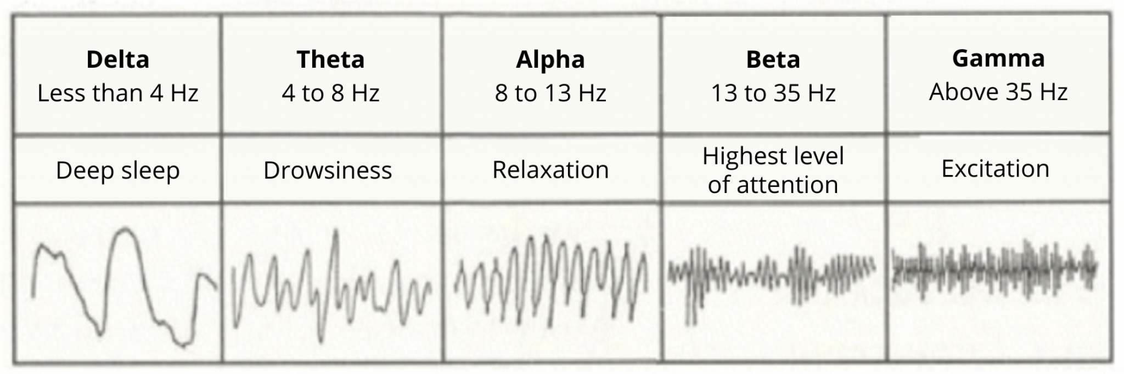
EEG Features
Differential entropy (DE);
Power spectral density (PSD);
Differential asymmetry (DASM);
Rational asymmetry (RASM);
Asymmetry (ASM);
Differential causality (DCAU).
https://pmc.ncbi.nlm.nih.gov/articles/PMC11351761/
https://speechneurolab.ca/en/electroencephalography-eeg/

Slide 14
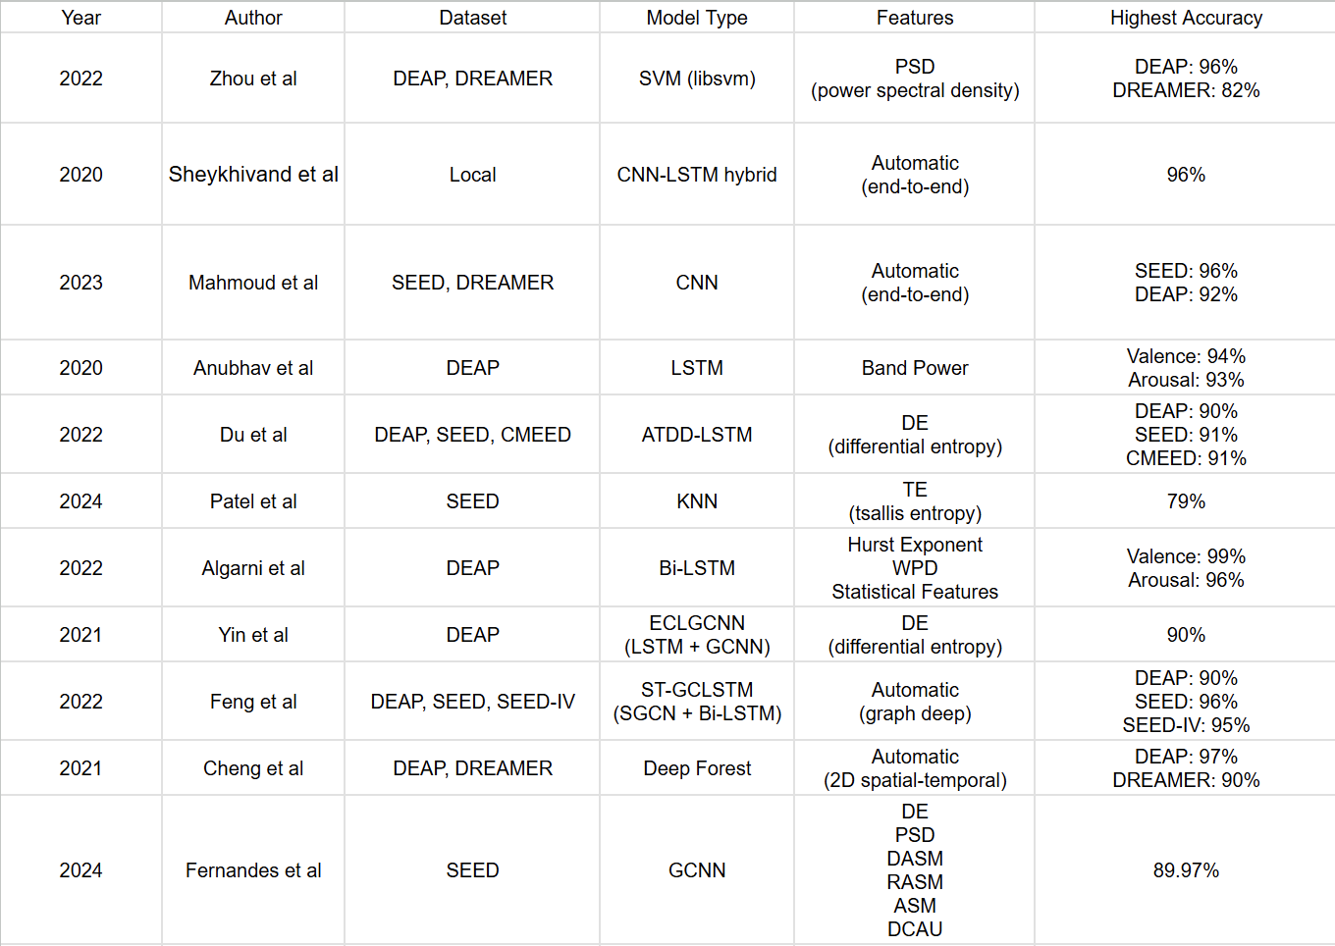
Emotion Classification Accuracy

Slide 15
03
Experiment Design
How should we respond to a detected emotion?

Slide 16
Questions to Consider!
What if the emotion detected is wrong?
What if the emotion detected is corrected, but the patient isn’t consciously aware or in agreement?
Assuming we correctly detect patient’s current emotion, how do we choose the music to play?

Slide 17

Experiment Design
😞
😊
1.
😞
😌
😊
2.
❓
3.

Slide 18
04
Music Generation
Techniques and Models

Slide 19
Goal of Generative AI
Traditional Machine Learning
Goal: Learn a mapping f : X→Y predict target outputs (e.g., labels, prices, categories) from inputs
Focus: Distinguishing between classes or estimating conditional probability P(Y∣X)
Optimization Objective:
Minimize prediction error or loss function (Mean Squared Error, Cross-Entropy).
Training Data Use: Uses labeled data to directly map features to outcomes.
Evaluation: Accuracy, precision, recall, RMSE, etc.
Examples: Logistic regression, SVMs, CNNs for classification
Generative AI
Goal: Learn the underlying data distribution P(X) or joint distribution P(X,Y) to generative new data
Focus: Modeling how data is structured to generate something new
Optimization Objective:
Minimize divergence between true data distribution P_data(x) and model distribution P_theta(x) (KL divergence, Jensen-Shannon)
Training Data Use: Can use labeled or unlabeled data (can learn latent structure)
Evaluation: Likelihood or human perceived quality
Examples: RNNs, VAEs, GANs, Diffusion Models

Slide 20
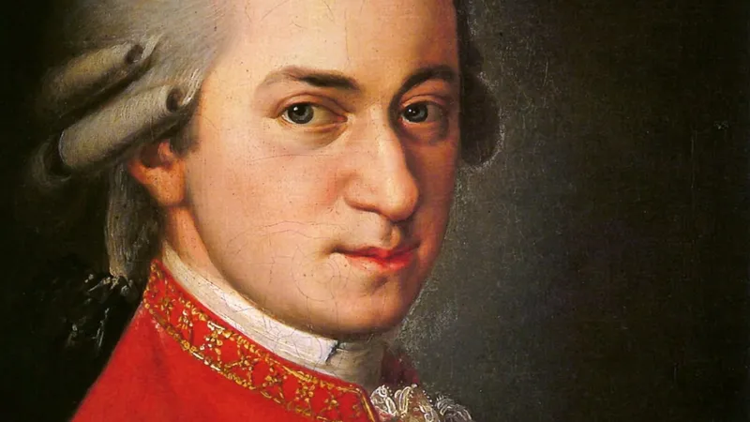
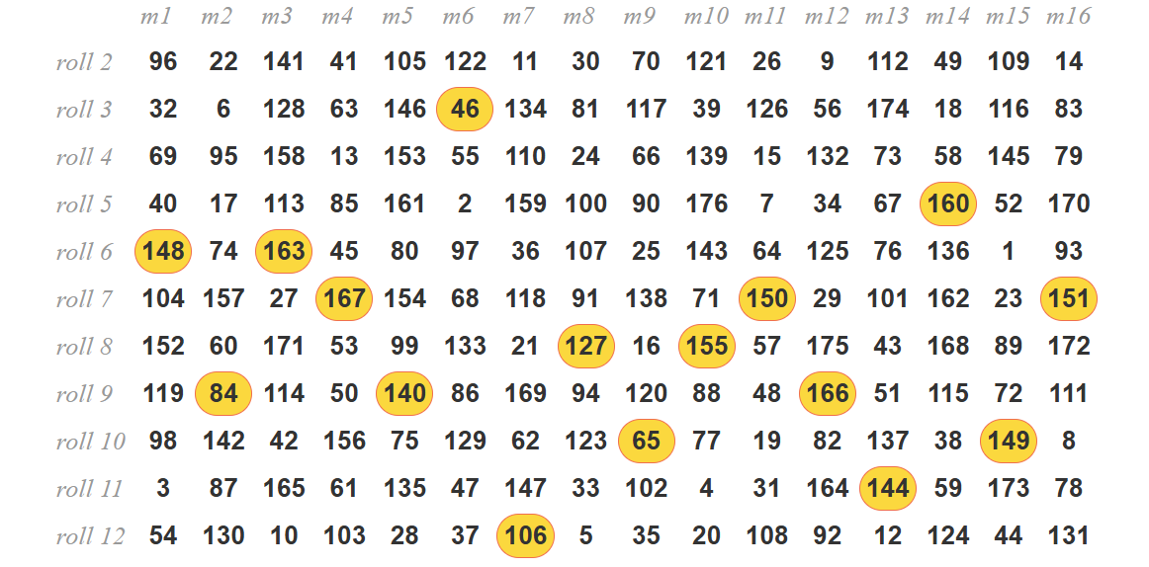
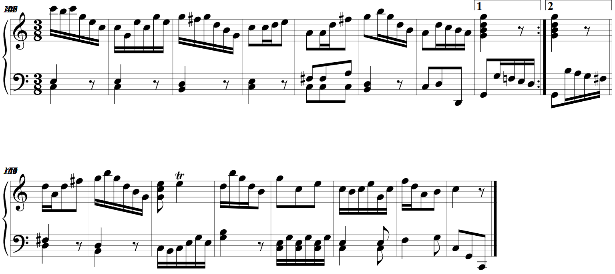
Mozart’s Dice Game (1792)
https://dice.humdrum.org/ https://www.playonlinedicegames.com/mozart

Slide 21
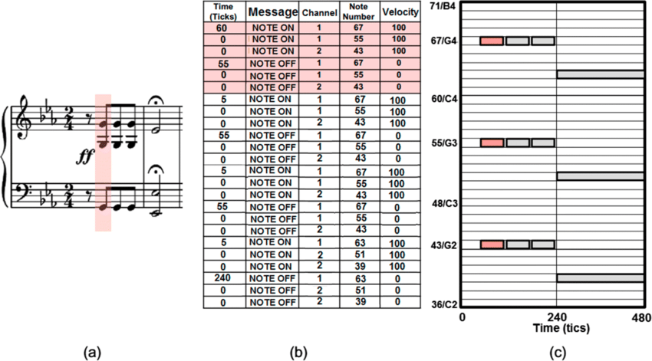
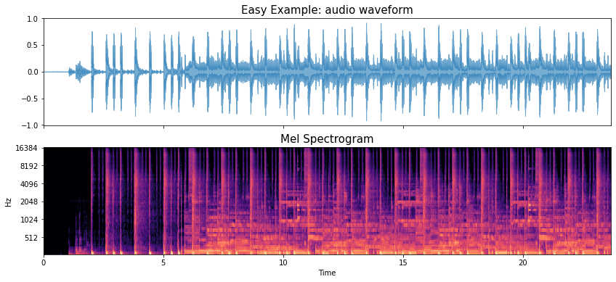
Symbolic vs. Waveform Representation
https://tempobeatdownbeat.github.io/tutorial/ch2_basics/baseline.html
(a) Sheet Music (b) MIDI (c) Piano Roll
https://www.researchgate.net/publication/359224559_Speech_and_music_separation_approaches_-_a_survey

Slide 22
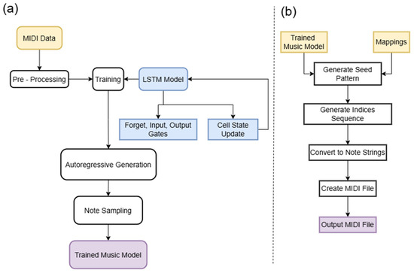
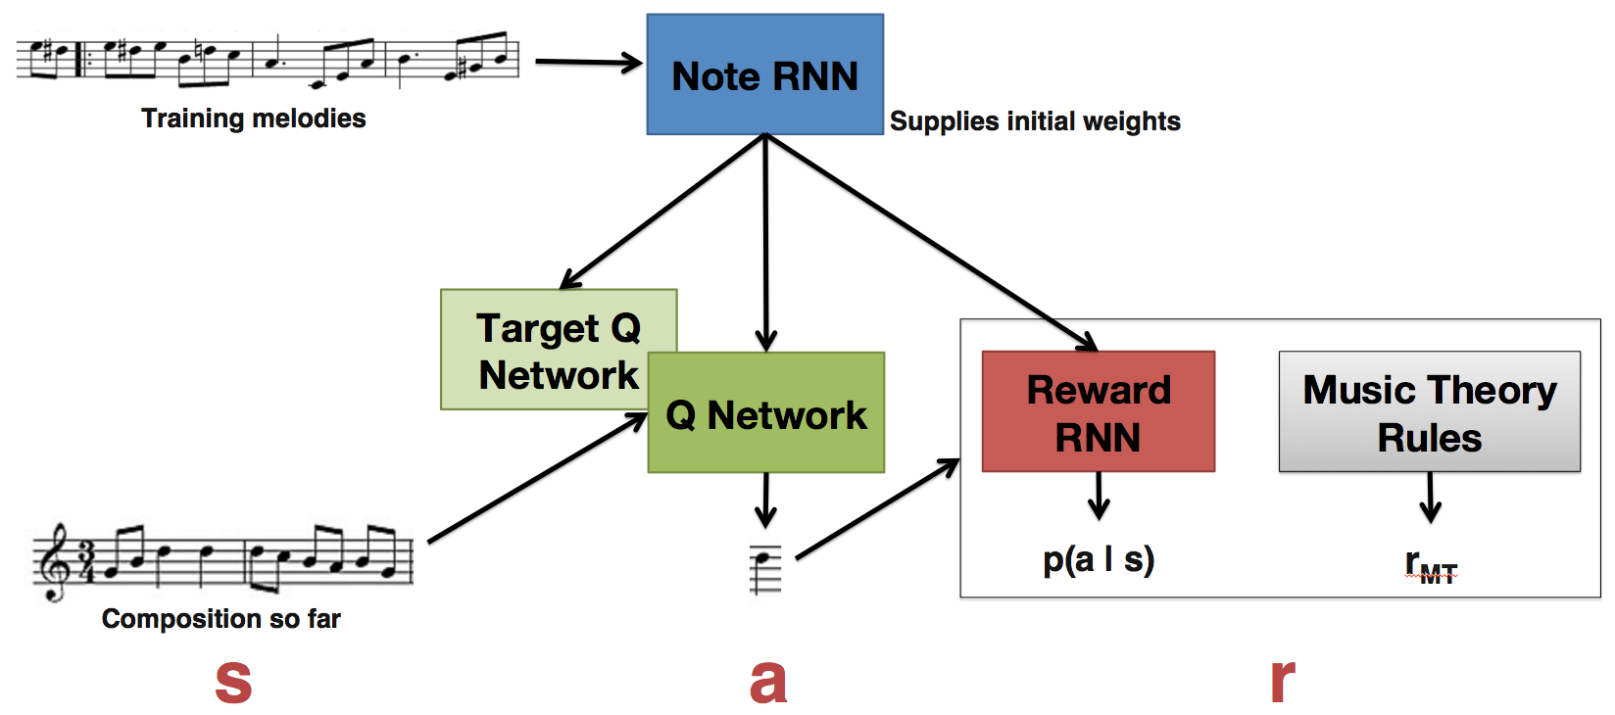
Approaches to AI Music Generation
Sequential Models (ex. LSTMs & RNNs)
https://magenta.withgoogle.com/2016/11/09/tuning-recurrent-networks-with-reinforcement-learning
https://www.mdpi.com/2073-431X/14/6/229

Slide 23
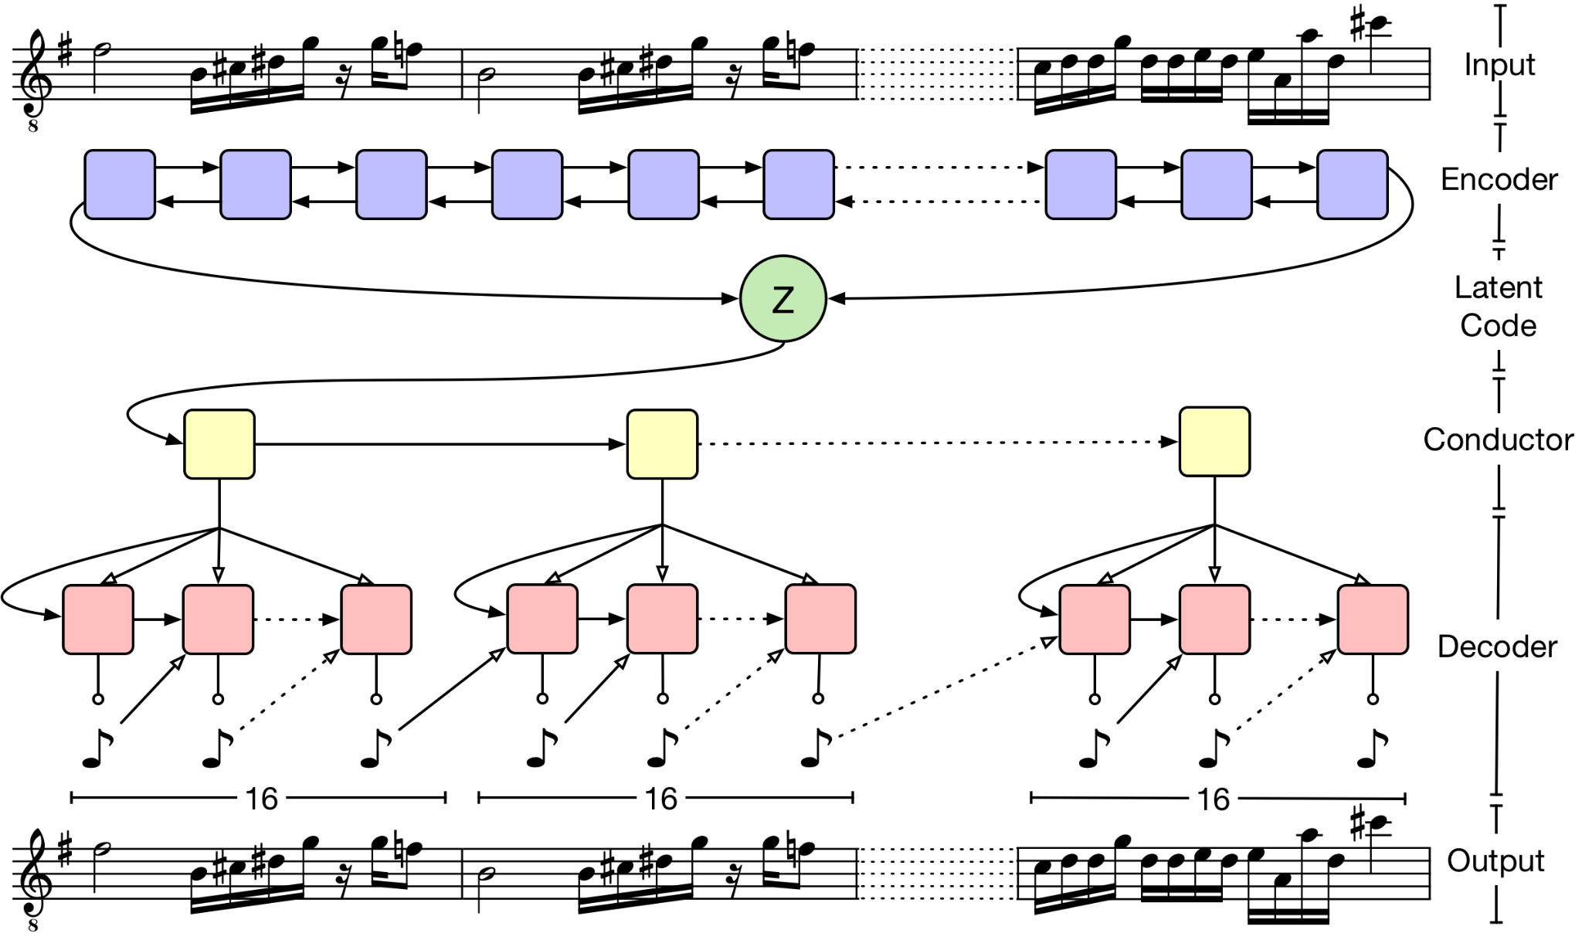
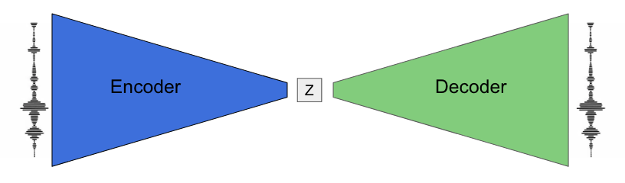
Approaches to AI Music Generation
Variational Autoencoders (VAEs)
https://magenta.withgoogle.com/music-vae

Slide 24
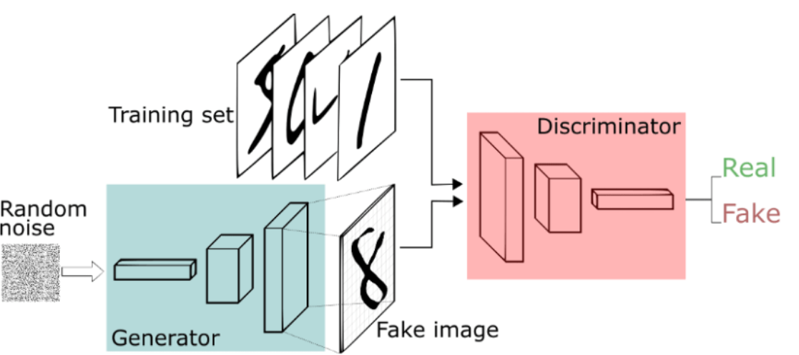
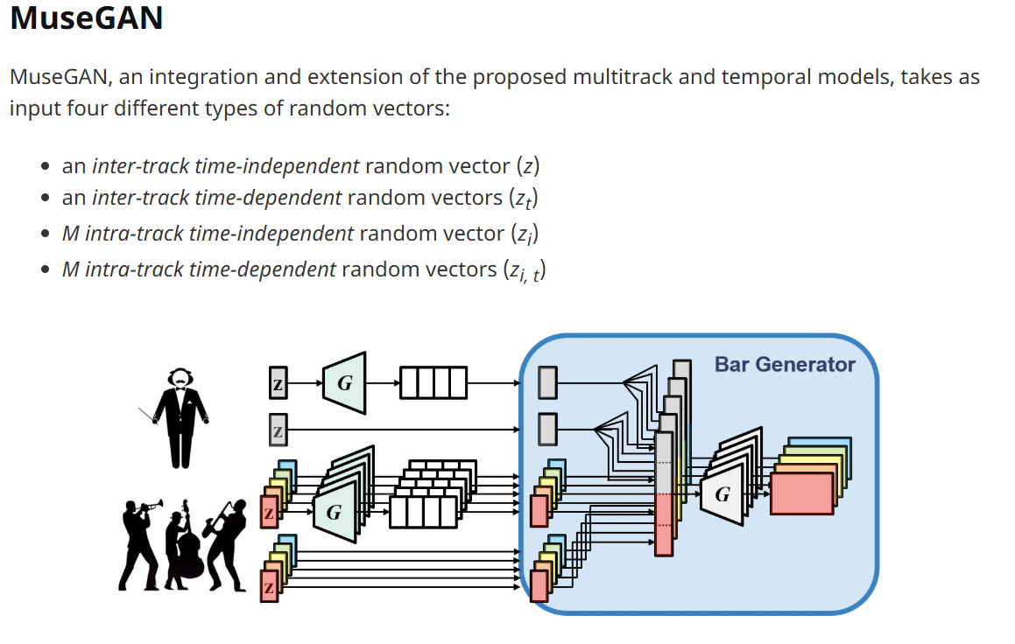
Approaches to AI Music Generation
Generative Adversarial Networks (GANs)
https://devpost.com/software/gan-music-generator
https://hermandong.com/musegan/model

Slide 25
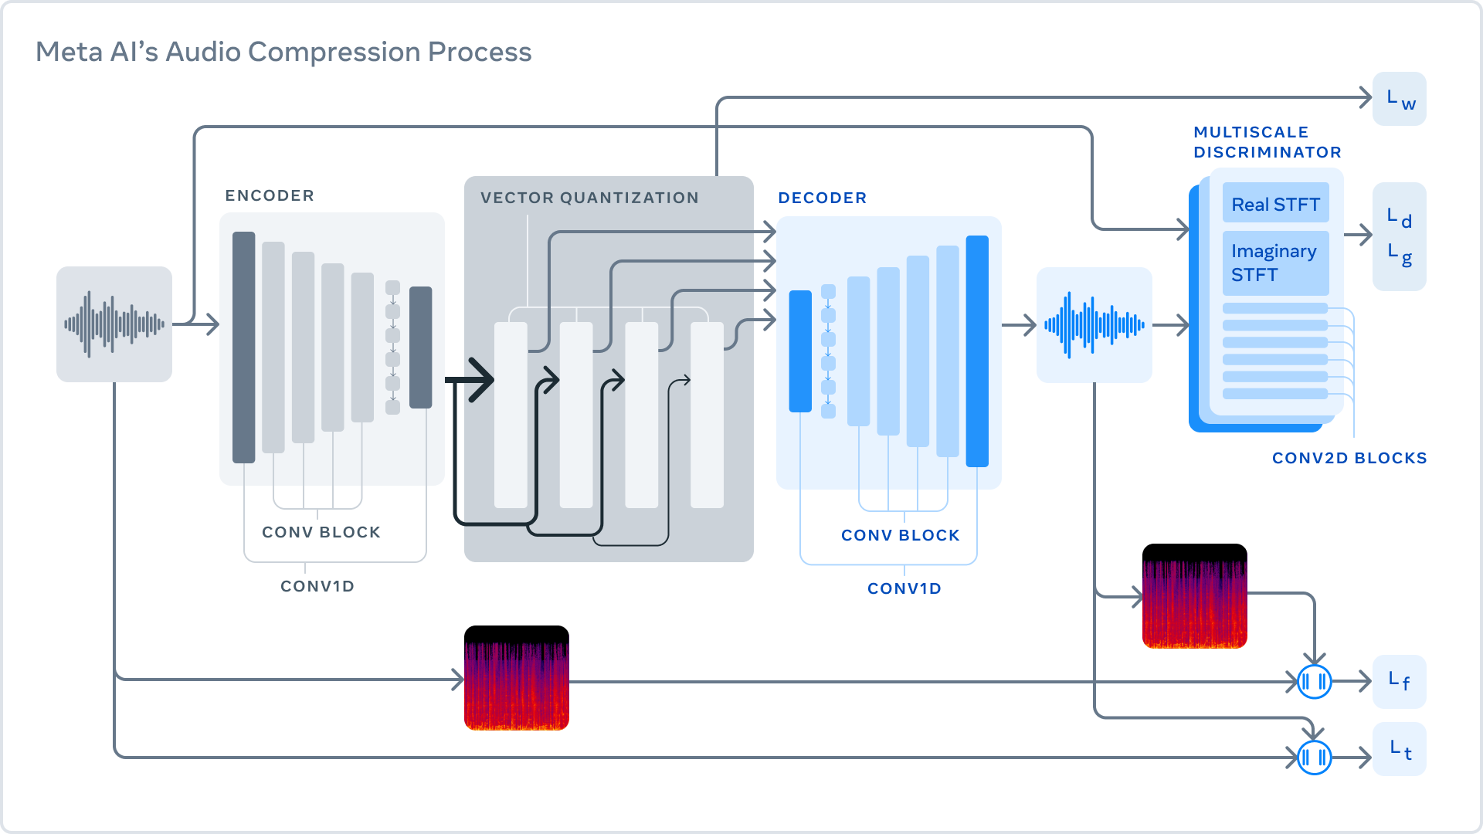
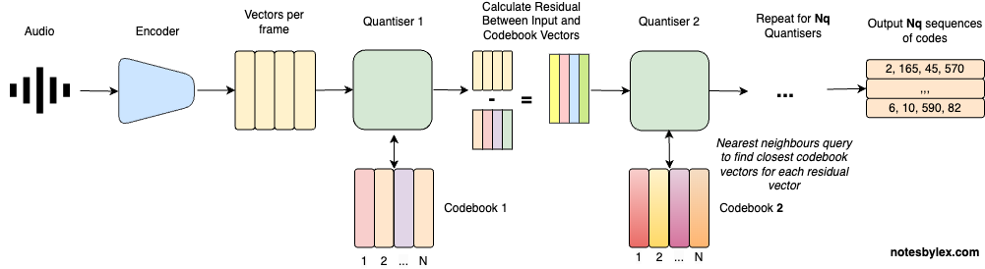
RVQ & EnCodec Representation
https://notesbylex.com/residual-vector-quantisation
https://docs.openvino.ai/2023.3/notebooks/234-encodec-audio-compression-with-output.html

Slide 26
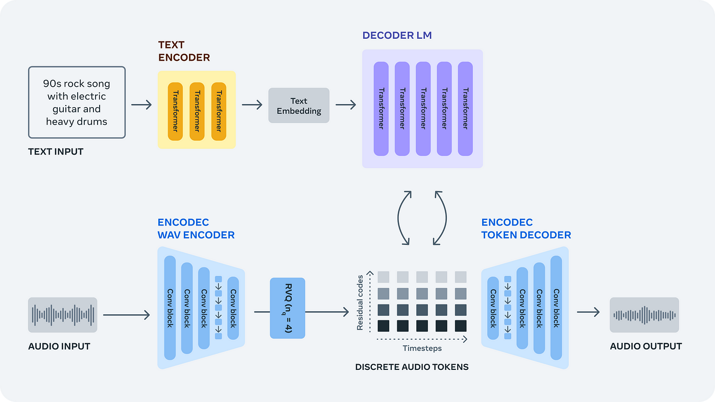
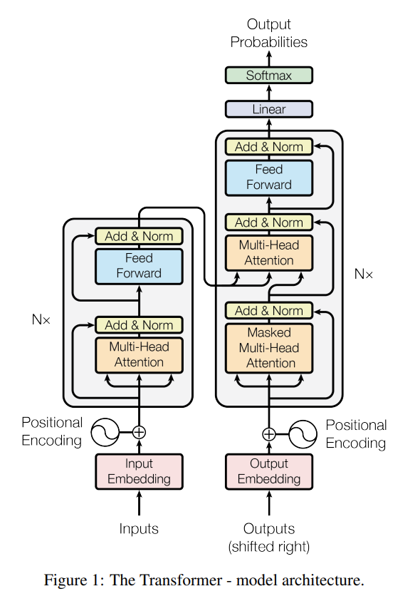
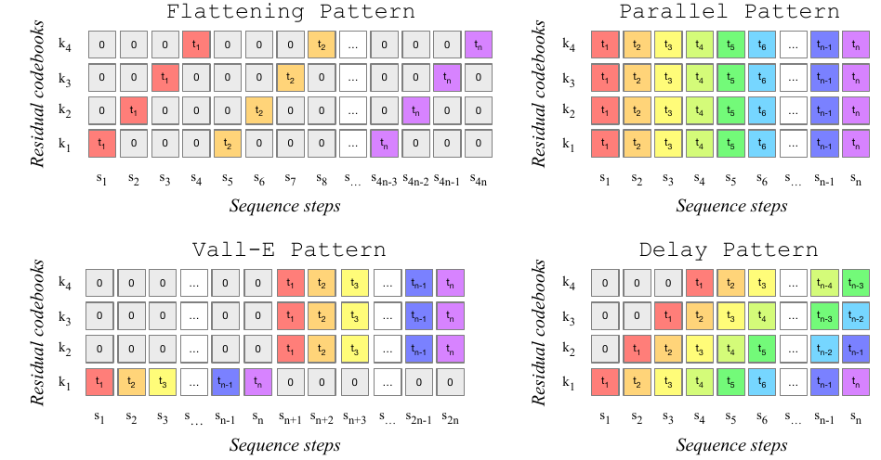
Approaches to AI Music Generation
Transformers (MusicGen)
https://arxiv.org/abs/2306.05284
https://ai.meta.com/blog/audiocraft-musicgen-audiogen-encodec-generative-ai-audio/
https://arxiv.org/abs/1706.03762

Slide 27
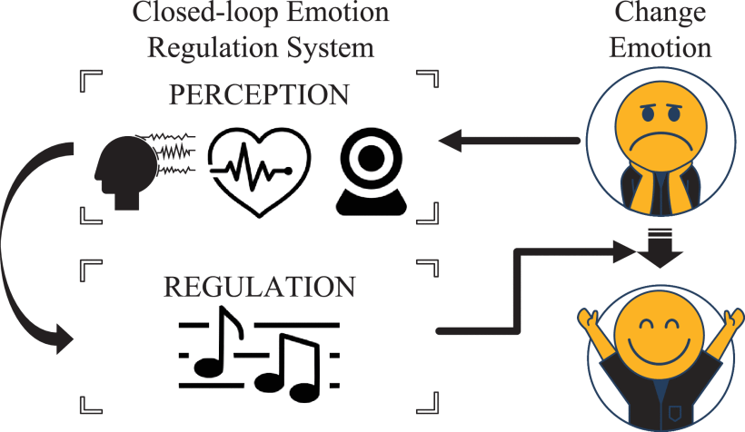
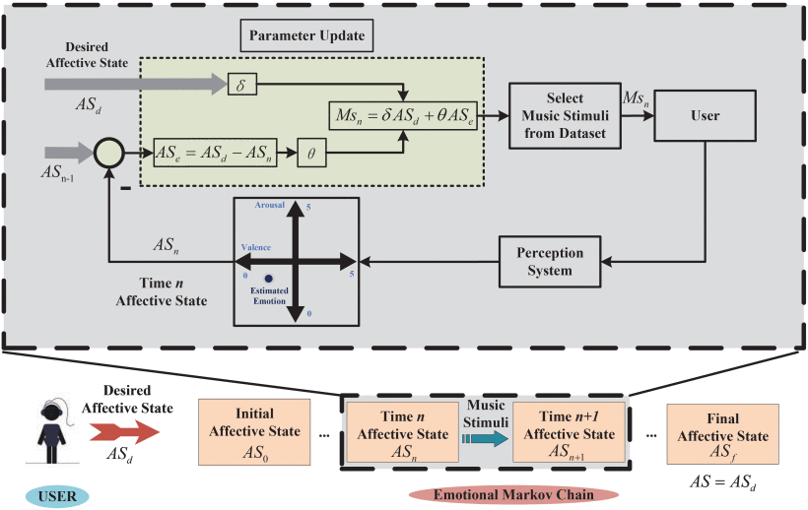
Putting It All Together
Wang et al - Design and Analysis of a Closed-Loop Emotion Regulation System Based on Multimodal Affective Computing and Emotional Markov Chain
https://ieeexplore.ieee.org/document/10836955

Slide 28
References
[1] National Center for Complementary and Integrative Health (NCCIH), “National Health Interview Survey 2022: Use of Complementary Health Approaches — 20-Year Trends.” [Online]. Available: https://www.nccih.nih.gov/research/national-health-interview-survey-2022/graph-titled-use-of-complementary-health-approaches-20-year-trends. [2] American Music Therapy Association, “What is Music Therapy?” [Online]. Available: https://www.musictherapy.org/about/musictherapy/. [3] Cleveland Clinic, “Music Therapy.” [Online]. Available: https://my.clevelandclinic.org/health/treatments/8817-music-therapy. [4] Clearvue Health, “Music Therapy and Depression (Data on Music Therapy).” [Online]. Available: https://www.clearvuehealth.com/b/music-therapy-depression/. [5] Frontiers in Human Neuroscience, “EEG overview (journal article page).” [Online]. Available: https://www.frontiersin.org/journals/human-neuroscience/articles/10.3389/fnhum.2023.1274834/full. [6] Medicai Blog, “What can an EEG show that an MRI cannot?” [Online]. Available: https://blog.medicai.io/en/what-can-an-eeg-show-that-an-mri-cannot/. [7] PeerJ Computer Science, “Article page (Big Picture of emotion/EEG).” [Online]. Available: https://peerj.com/articles/cs-2065/. [8] M. Chlasta et al., “Seemo: A Computational Approach to See Emotions,” ResearchGate article page. [Online]. Available: https://www.researchgate.net/publication/324664655_Seemo_A_Computational_Approach_to_See_Emotions. [9] Multimedia Tools and Applications (Springer), “Article page (valence–arousal / emotion classification).” [Online]. Available: https://link.springer.com/article/10.1007/s11042-023-14489-9. [10] U.S. National Library of Medicine, PubMed Central (PMC), “EEG emotion classification accuracy (survey/article).” [Online]. Available: https://pmc.ncbi.nlm.nih.gov/articles/PMC11351761/. [11] Speech Neurolab, “Electroencephalography (EEG).” [Online]. Available: https://speechneurolab.ca/en/electroencephalography-eeg/. [12] Center for Computer Assisted Research in the Humanities (CCARH), “Mozart’s Dice Game (Humdrum Dice).” [Online]. Available: https://dice.humdrum.org/. [13] Play Online Dice Games, “Mozart’s Dice Game.” [Online]. Available: https://www.playonlinedicegames.com/mozart. [14] ResearchGate, “Speech and music separation approaches — a survey.” [Online]. Available: https://www.researchgate.net/publication/359224559_Speech_and_music_separation_approaches_-_a_survey. [15] Tempo/Beat/Downbeat Tutorial, “Basics: baseline representations.” [Online]. Available: https://tempobeatdownbeat.github.io/tutorial/ch2_basics/baseline.html. [16] Google Magenta, “Tuning Recurrent Networks with Reinforcement Learning (blog).” [Online]. Available: https://magenta.withgoogle.com/2016/11/09/tuning-recurrent-networks-with-reinforcement-learning. [17] MDPI — Computers, “Article page (Sequential models for music generation).” [Online]. Available: https://www.mdpi.com/2073-431X/14/6/229. [18] Google Magenta, “MusicVAE.” [Online]. Available: https://magenta.withgoogle.com/music-vae. [19] Devpost, “GAN Music Generator.” [Online]. Available: https://devpost.com/software/gan-music-generator. [20] H. Dong, “MuseGAN — Model.” [Online]. Available: https://hermandong.com/musegan/model. [21] W. Wang, Z. Jin, and L. Wang, “Design and Analysis of a Closed-Loop Emotion Regulation System Based on Multimodal Affective Computing and Emotional Markov Chain,” in Proc. IEEE (IEEE Xplore Doc. no. 10836955), 2024. [Online]. Available: https://ieeexplore.ieee.org/document/10836955.

Slide 29
Q&A

Slide 30

AI In Creative Fields & Ethics
Ethical Concerns
Environmental Impacts
Innovation With Responsibility

